Slide 1
Domain generalization
domain generalization是domain adaptation中的一种特殊的技术，其目的是基于domain adaptation技术，学习对于任何不可见的target domain的具有很强鲁棒性的分类器。
1.目标域不可见
2.要对任何目标域都起作用。(这里的任何并不是广义上的任何)
目标域不可知

Slide 2
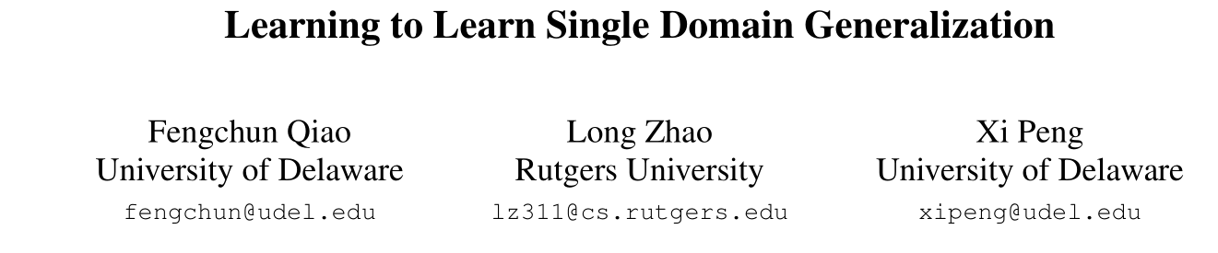
CVPR 2020
a model aims to perform well on many unseen domains while there is only one single domain available for training.
Method: adversarial domain augmentation to solve this Out-of-Distribution (OOD) generalization problem
Key idea: leverage adversarial training to create “fictitious”yet “challenging” populations. cast the model training in a meta-learning scheme and use a Wasserstein Auto-Encoder (WAE) to relax the widely used worst-case constraint.
0abstract

Slide 3
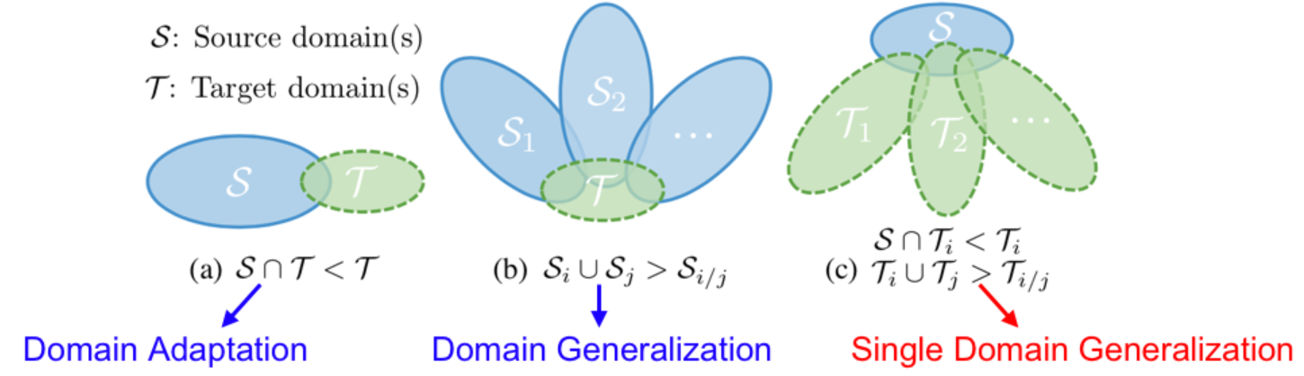
domain discrepancy
Different from domain adaptation, domain generalization aims to learn from multiple source domains without any access to target domains.
1Instruction

Slide 4
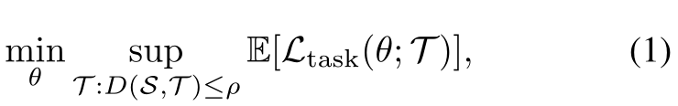

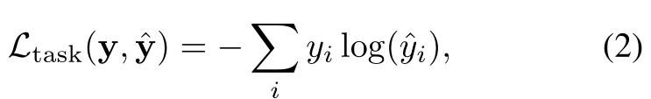

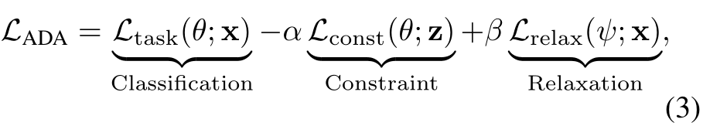
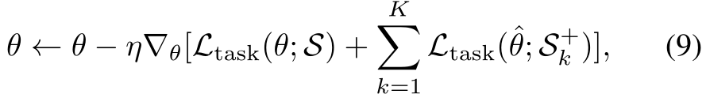
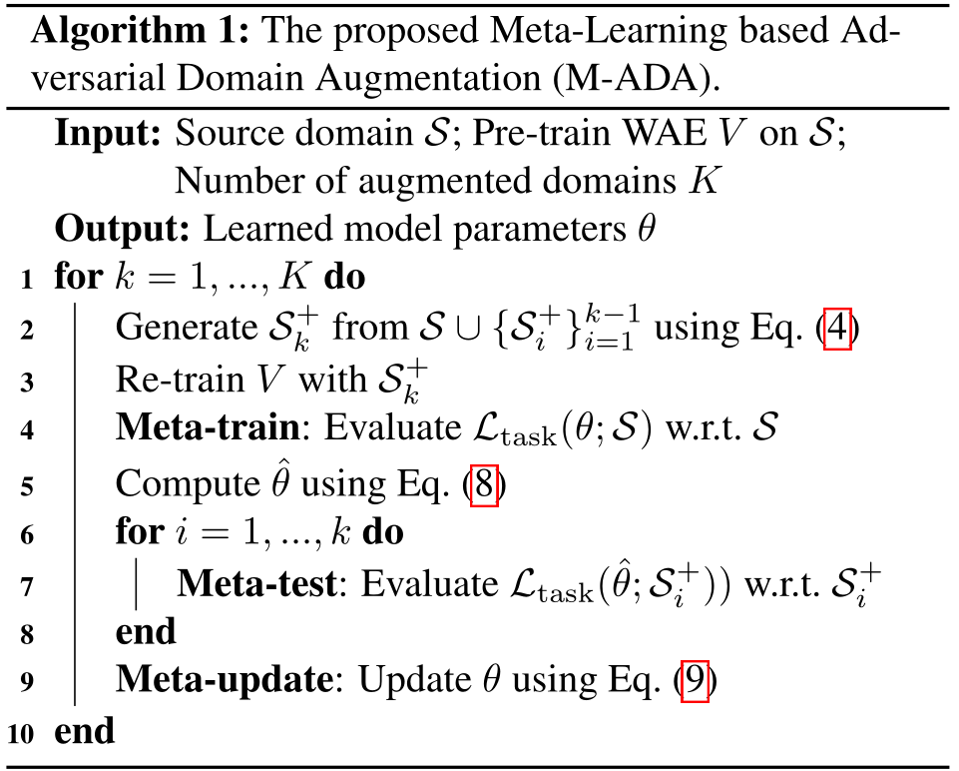

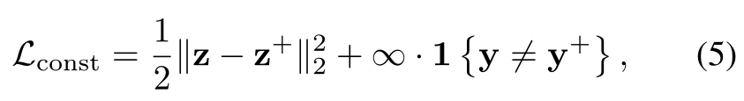
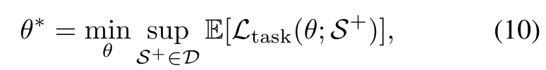

Slide 5
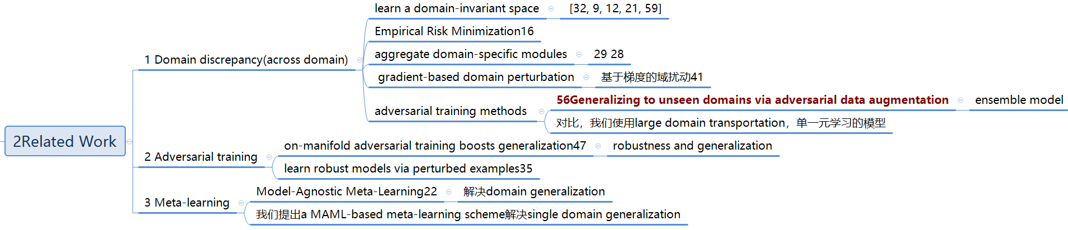
a Model-Agnostic Meta-Learning (MAML)
2Related Work

Slide 6

A model is trained on only one source domain S but is expected to generalize well on many unseen target domains T
worst-case problem
D is a similarity metric to measure the domain distance
ρ denotes the largest domain discrepancy between S and T
θ are model parameters that are optimized according to a task-specific objective function Ltask
Meta-Learning based Adversarial Domain Augmentation (M-ADA)
3Method

Slide 7
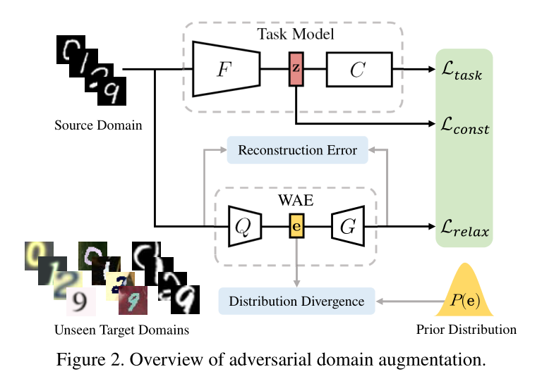
3.1Adversarial Domain Augmentation
3.2Relaxation of Wasserstein Distance Constraint
3.3. Meta-Learning Single Domain Generalization
3Method

Slide 8
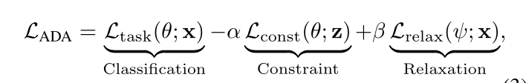


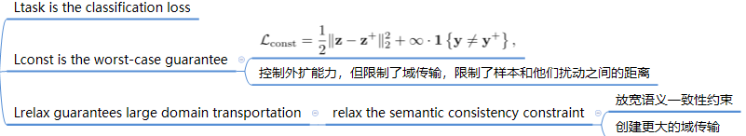
3.1 Adversarial Domain Augmentation.
Ltask is the classification loss：交叉熵分类损失
Lconst is the worst-case guarantee
Lrelax guarantees large domain transportation
α and β are two hyper-parameter to balance Lconstand Lrelax.
3Method

Slide 9
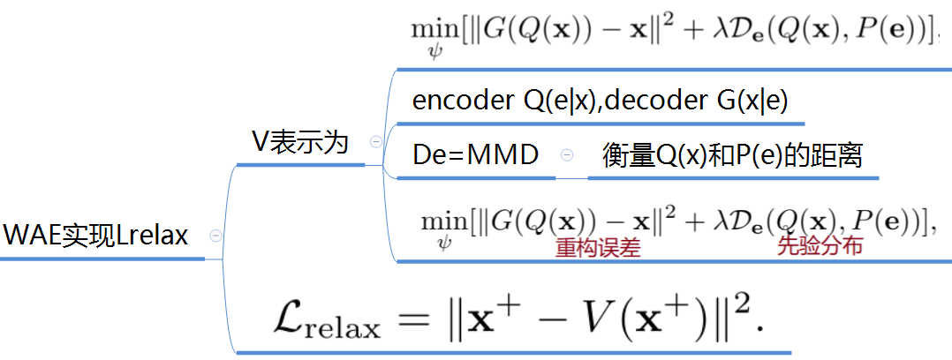
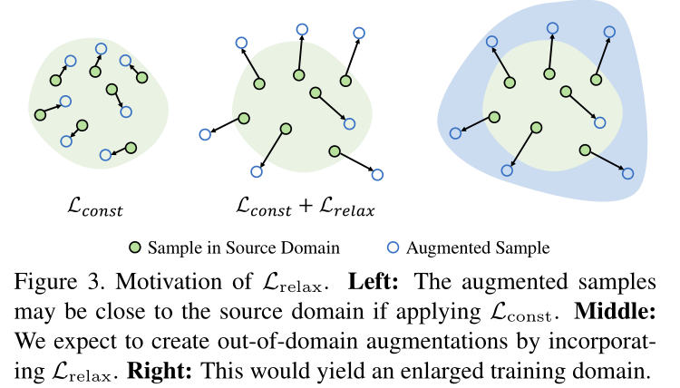
3.2. Relaxation of Wasserstein Distance Constraint
V consists of an encoder Q(e|x) and a decoder G(x|e) where x and e denote inputs and bottleneck embedding, respectively.
Wasserstein Auto-Encoders (WAEs) to implement Lrelax

Slide 10
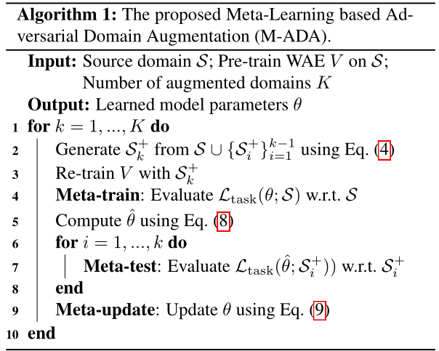
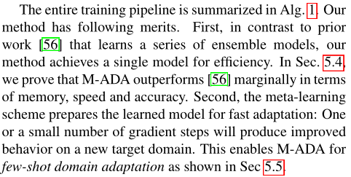
3.3. Meta-Learning Single Domain Generalization
meta-train, meta-test and meta-update

Slide 12
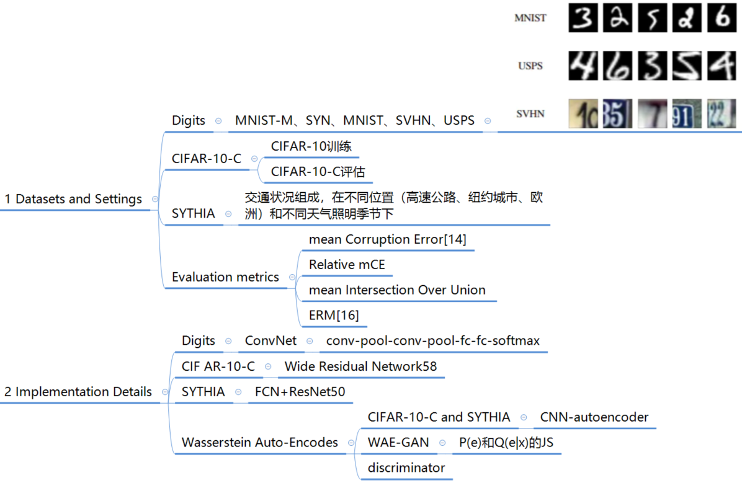
5. Experiments
Datasets and Settings

Slide 13
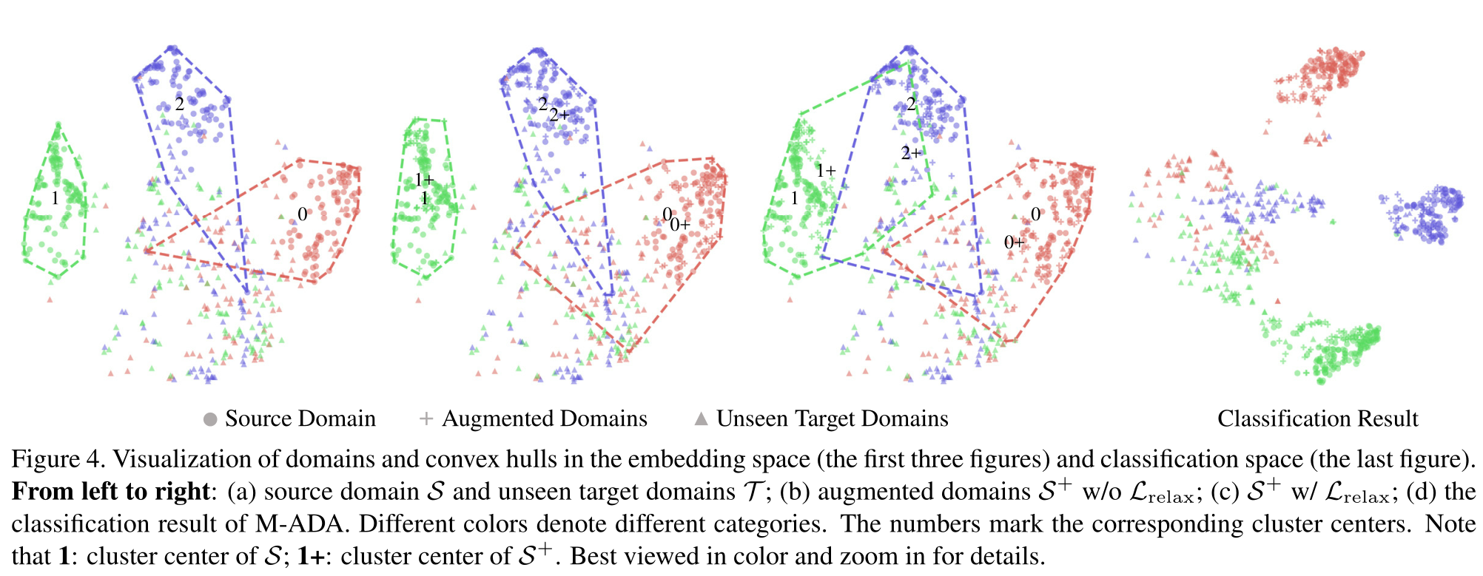
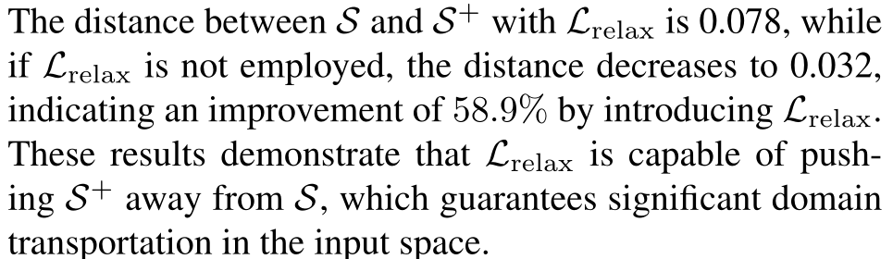
5.3. Ablation Study
Validation of Lrelax：
使用t-SNE进行可视化

Slide 14
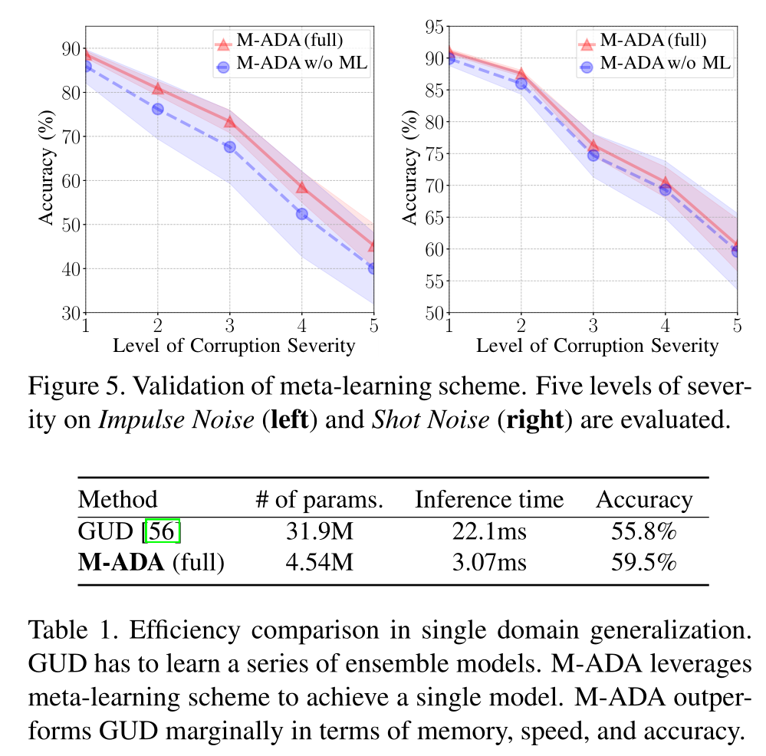
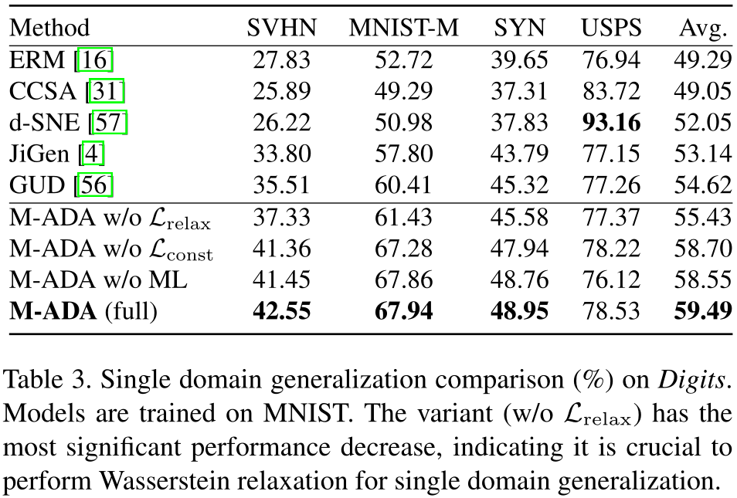
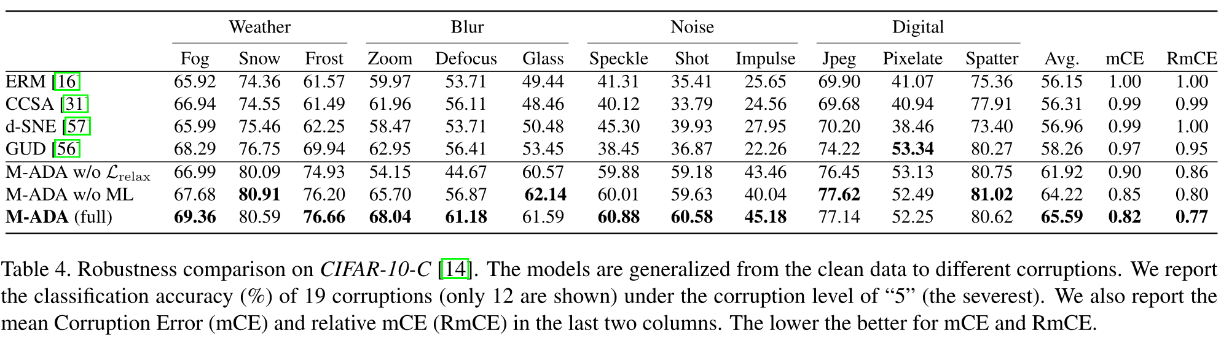
Validation of meta-learning scheme:
corruptions
0.94%
1.37%

Slide 15
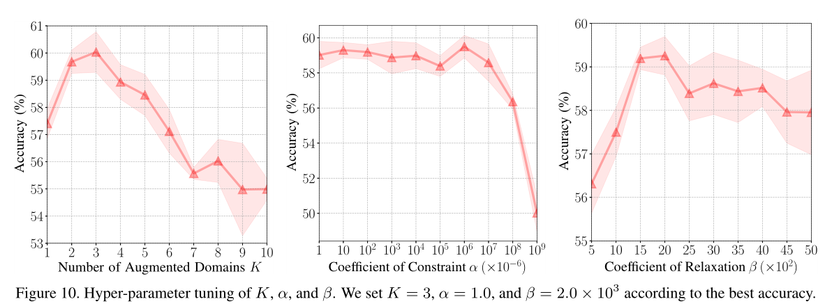
Hyper-parameter tuning of K, α, and β
the number of augmented domains (K), the distance between the source and augmented domain in the embedding space (α), and the deviation between the source and augmented domain (β)

Slide 16
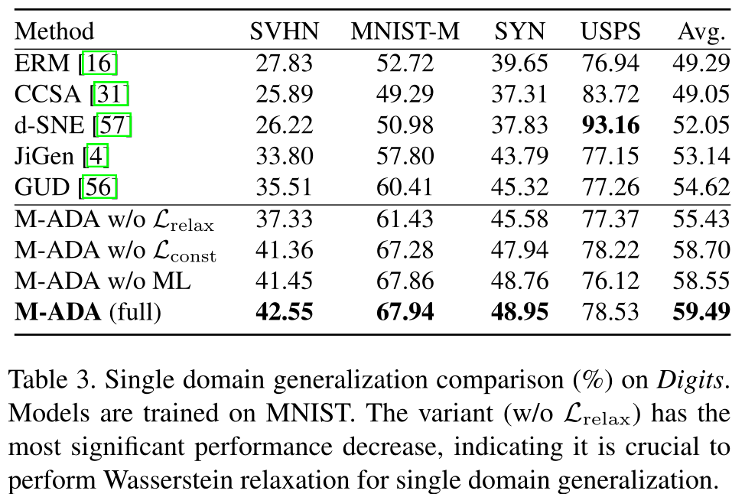
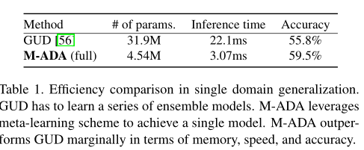
5.4 Evaluation of Single Domain Generalization
Comparison on Digits

Slide 17
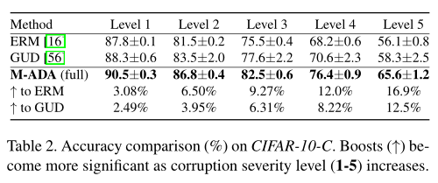
Comparison on CIFAR-10-C:

Slide 18
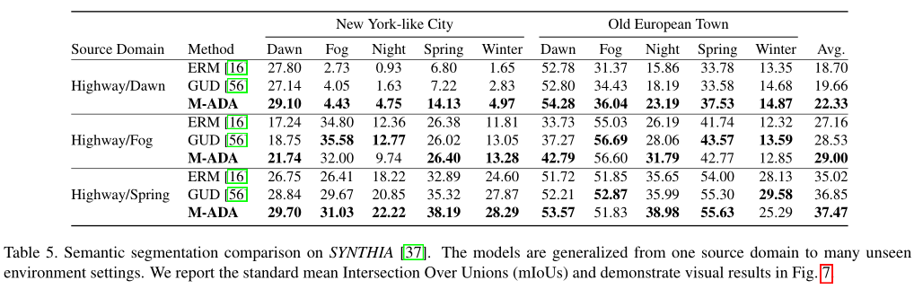
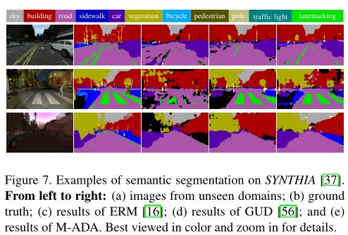
Comparison on SYTHIA

Slide 19
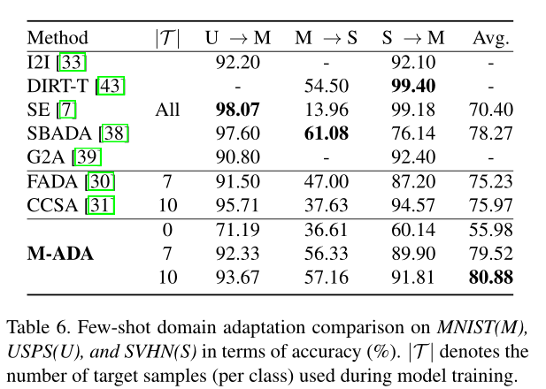
5.5 Evaluation of Few-Shot Domain Adaptation

Slide 20
6 Conclusion
Meta-Learning based Adversarial Domain Augmentation (M-ADA) to address the problem of single domain generalization
The core idea is to use a meta-learning based scheme for efficiently organizing the training of augmented “fictitious” domains, which are OOD from source domain and created by adversarial training。In the future, we expect to further extend our work to address regression problems, or knowledge transferring in multimodal learning.

Slide 21
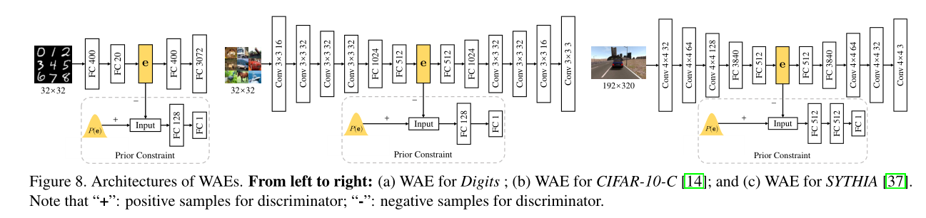
Appendix A. Experimental Details
Task models

Slide 22
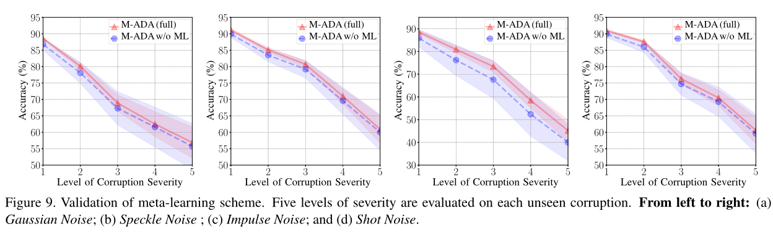
Appendix B. Additional Experimental Results
Validation of meta-learning scheme

Slide 23
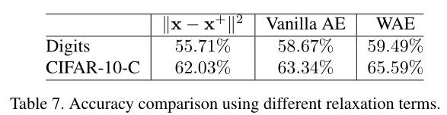
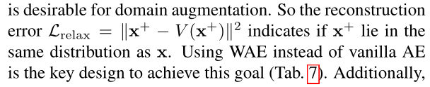
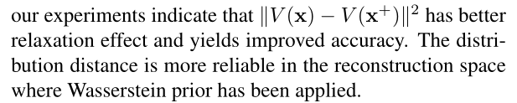
Comparison of Different Lrelax
Wasserstein metric to measure the distribution distance between the input and reconstruction
relaxation effect

